Slide 1
IOT Home appliance │ Cordova and Firebase

Slide 2
What is Cordova ?
Overview
Apache Cordova is an open-source mobile development framework. It allows you to use standard web technologies - HTML5, CSS3, and JavaScript for cross-platform development. Applications execute within wrappers targeted to each platform, and rely on standards-compliant API bindings to access each device's capabilities such as sensors, data, network status, etc.
Suitable For Rapid Application Development

Slide 3
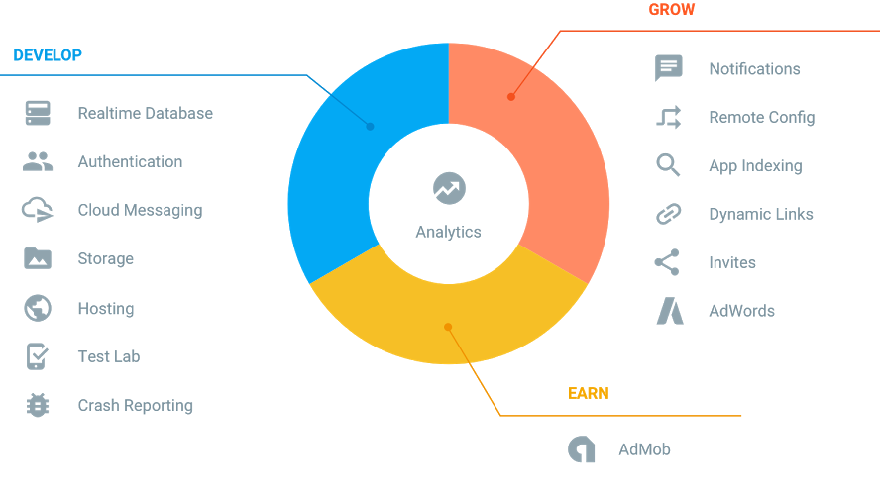

What is Firebase ?
Forget about infrastructure
Free to start, scale with ease

Slide 4
IOT Home appliance │ Hardware And Wiring

Slide 5
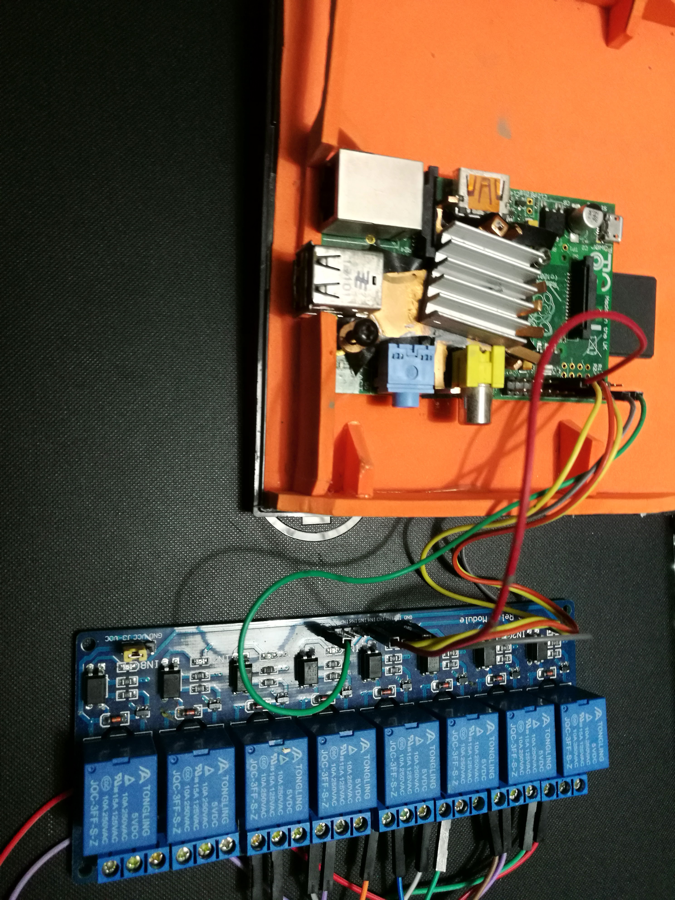
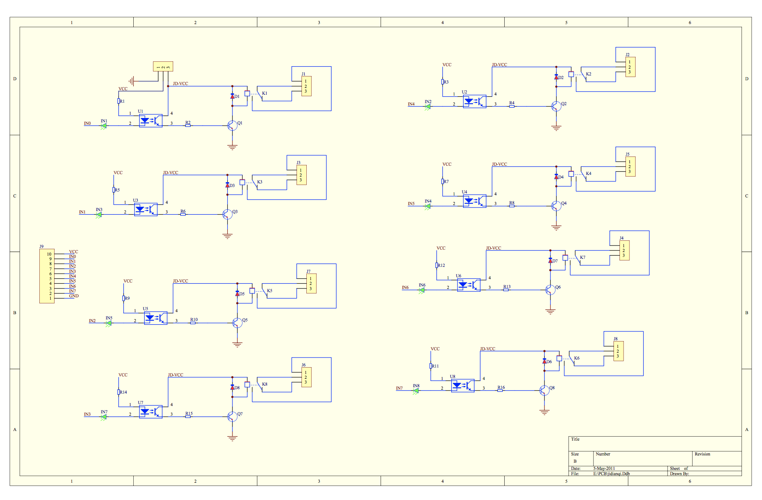
Hardware And Wiring
Wiring
Raspberry pi 2 GPIO pin [ . ][ x ] >> To Relay VCC [ . ][ . ] [ . ][ x ] >> To Relay GND [ . ][ . ] [ . ][ . ] [ x ][ x ] >> To Relay IN1,IN2 [ x ][ . ] >> To Relay IN3 [ x ][ . ] >> To Relay IN4
Changing pieces of the pie
Raspberry Pi 2 model B with Rasbian OS – Mainboard 5V RELAY 8-CH 10A 250VAC GTTH-1015 - For Controling Electricity

Slide 6
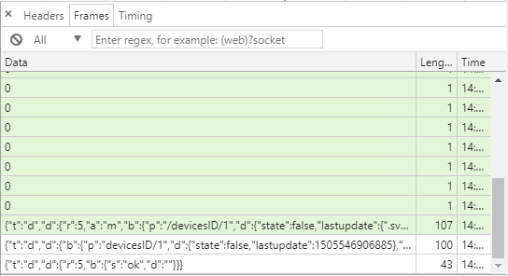
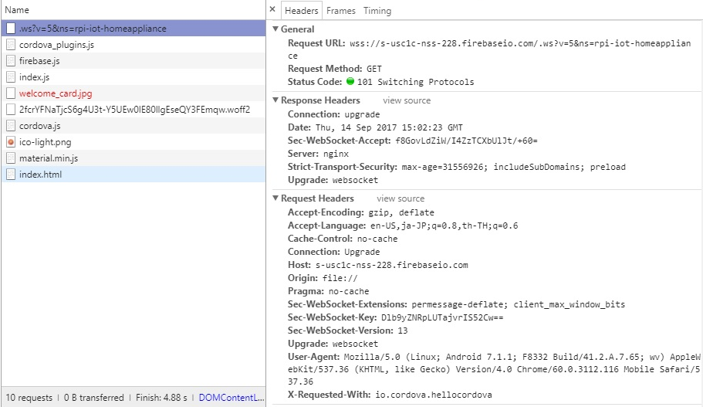
Network Packet
Changing pieces of the pie
โดยเริ่ม request ขอ URL ไปที่ server ของ wss://s-usc1c-nss-228.firebaseio.com/.ws?v=5&ns=rpi-iot-homeappliance มีการใช้ Request Method GET ซึ่งมี status code เป็น 101 Switching Protocols และยังคงเป็น stay alive จาก Function ที่ชื่อว่า Present ใน code js ของ Client ทำให้ยังไม่มีการปิด connetion

Slide 7
IOT Home appliance │ Test the application and demo

Slide 8
IOT Home appliance │ สรุป

Slide 9
Repository
https://github.com/Telexine/RPI-IOT-HomeAppliance/

